Slide 1

AI DIETICIAN
DEPARTMENT:IT
CLASS:BE
GROUP NO-14
NEHA GILBILE(ROLL NO-16)
ALTAF SAYAD(ROLL NO-45)
SAURABH YADAV(ROLL NO-62)

Slide 2
ABSTRACT :
This system acts in a similar way as that of a dietician. A person in order to know his/her dietplan needs to give some information to the dietician such as its body type, weight, height details.
Similar way this system also provides the dietplan according to the information entered by the user. The system asks all his data from the user and processes it to provide the diet plan to the user. The user can select multiple diet plans related to the Health issues.

Slide 3
INTRODUCTION :
Smart phones and the Internet have revolutionized the communication and with it the lifestyle of people. An increasing number of smart phones and Personal Digital Assistants (PDA) allow people to access the Internet where ever they are and whenever they want.
Artificial dietician is an application with artificial intelligence about human diets. It acts as a diet consultant similar to a real dietian .
This system acts in a similar way as that of a dietician .A Person in order to know his/her diet plans needs to give some information to the dietitian such as its body type, weight, height, and working hour details.

Slide 4
LITERATURE SURVEY :
EXISTING SYSTEM :
Dietician and user have to consult each other directly if any information is needed. If any new user come for diet schedule, dietician and his staff has to search the user details and they have to find the dietician schedule for that particular diet. Here searching for eligible diet takes lots of time. And sometimes some users’ details may be missed.
1. According to current health survey in India there are more then 70% of people suffer from one or the other disease.
2. This is because they don’t know how much they should eat.
3. People avoid going to nutritionists or diet planner because of their high fees.
4. Unaware of amount of fat required by body.

Slide 5
PROPOSED SYSTEM :
“Artificial Intelligence Dietician” is a BOT with artificial intelligence about human diets.
It acts as a diet consultant similar to a real Dietician
User may log in and view various diet information
A Dietician consults a person based on his schedule, body type, height and weight. The system too asks all this data from the user and processes it.

Slide 6
FEATURES :
Load Balancing
Easy Accessibility
User Friendly
Efficient and reliable
Easy maintenance

Slide 7
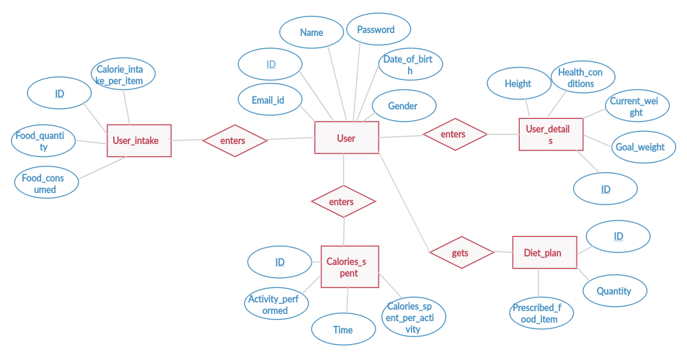
PROJECT DESIGN :

Slide 8
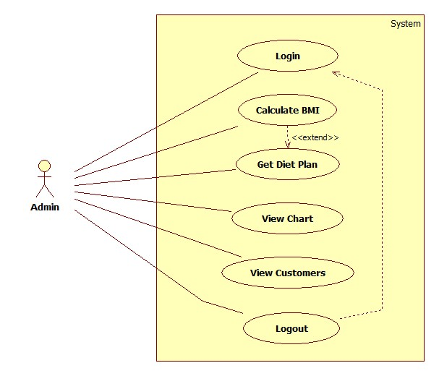
- USE CASE DIAGRAM OF ADMIN

Slide 9
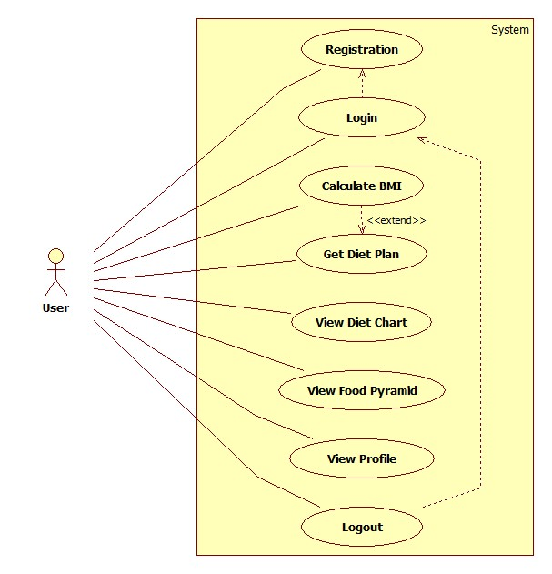
- USE CASE DIAGRAM OF USER

Slide 10
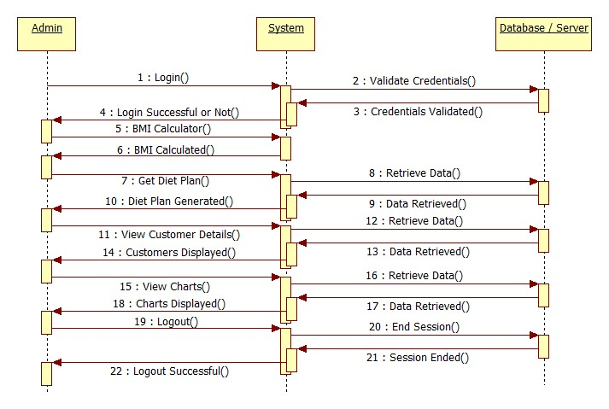
SEQUENCE DIAGRAM OF ADMIN

Slide 11
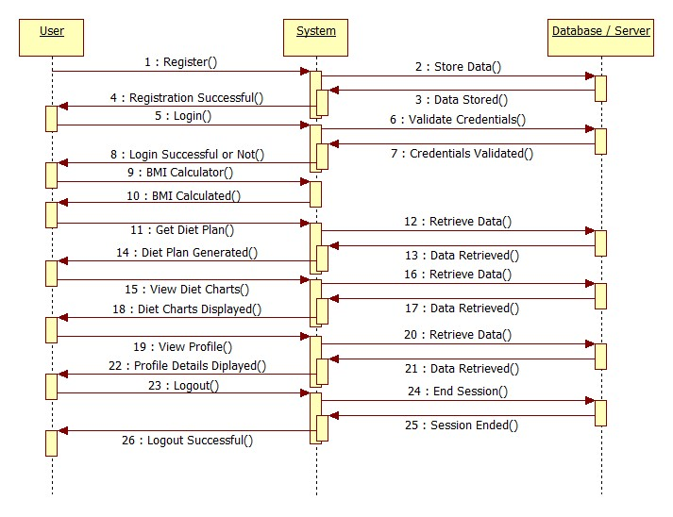
SEQUENCE DIAGRAM OF USER

Slide 12
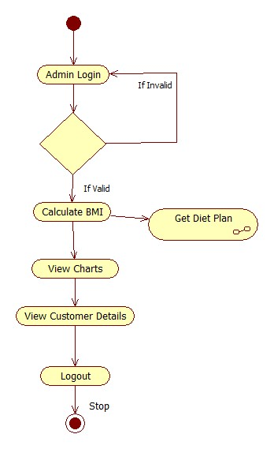
ACTIVITY DIAGRAM: (ADMIN)

Slide 13
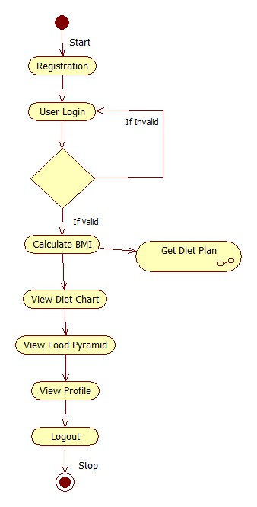
ACTIVITY DIAGRAM : (USER)

Slide 14
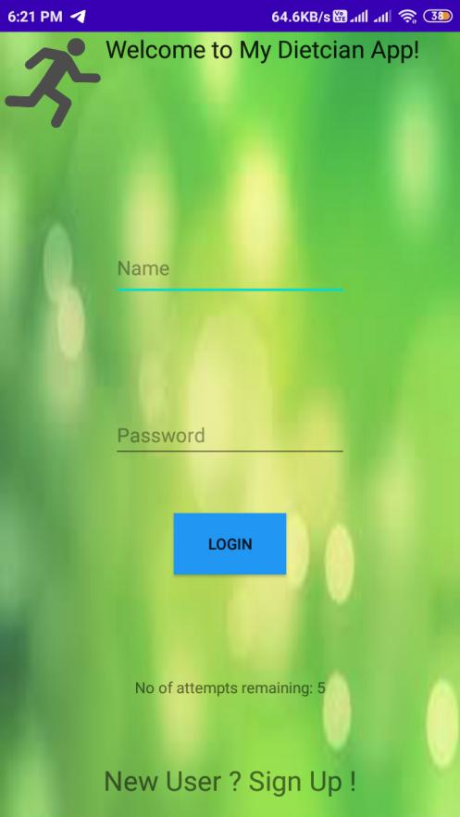
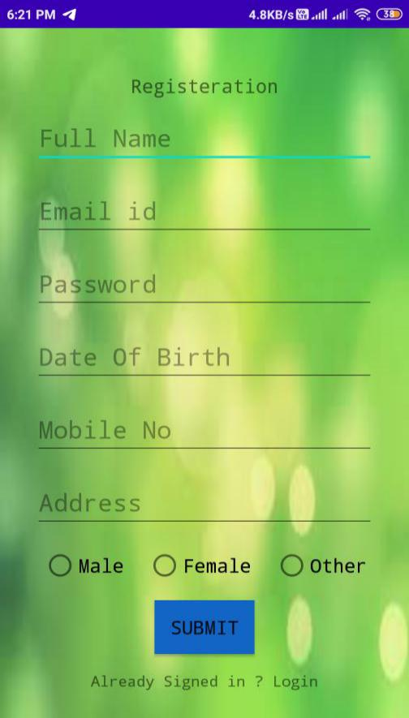
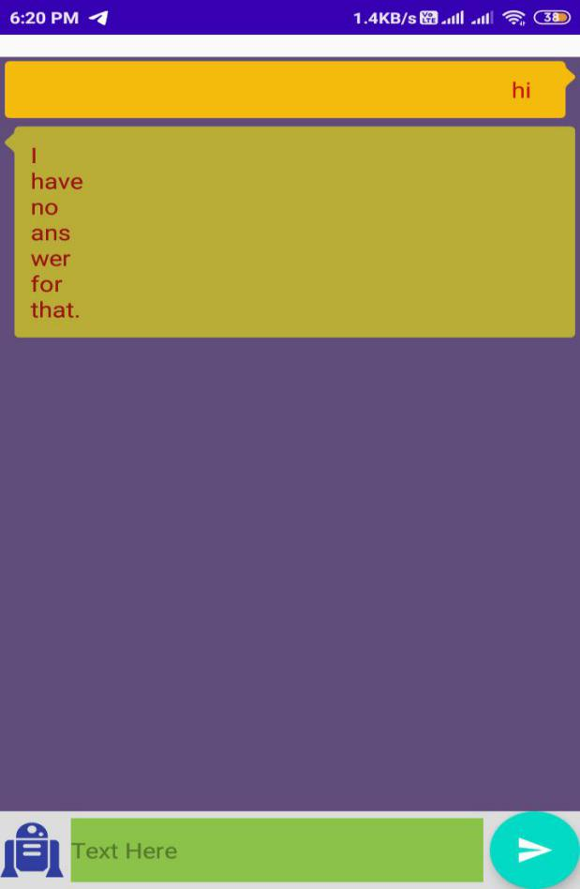
EXPECTED RESULT :
User or Admin Login
User Registeration
Chatbot that can help users

Slide 15
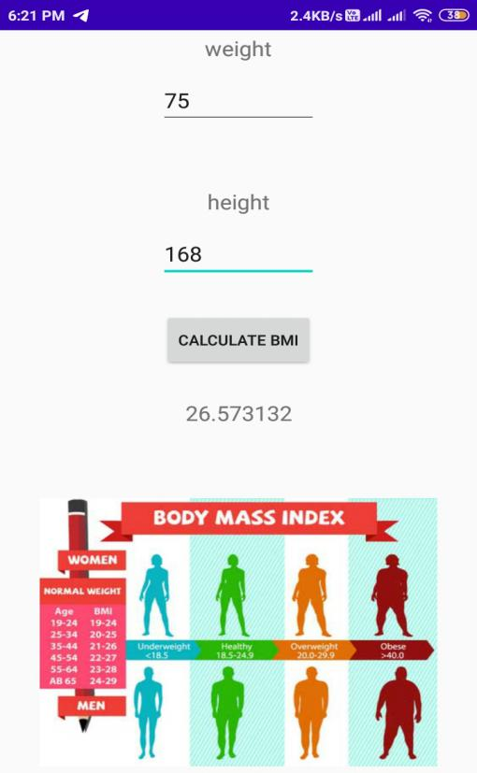
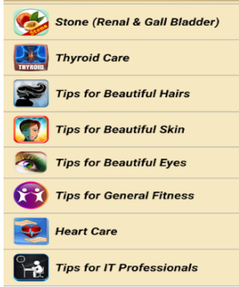
Diet plan for users according to their health Issues
Calculates BMI

Slide 16
Hardware & Software
Hardware Requirements
Processor –Core i3
Hard Disk – 500 GB
Memory –4 GB RAM (Minimum)
Monitor
Software Requirements
Windows 7 or higher
Java
JDK
Firebase
Android Studio

Slide 17
Future Scope
The project is easily extensible and can be improved by further incremental releases Of the same. We plan to focus on improving the overall performance of the system. Also, interaction between guider and dietitian through video calling and secure prescription will be focused upon. Some more ways to achieve dietitian will be focused.

Slide 18
Conclusion
Our approach for implementing this project is we have implemented the artificial intelligent dietician using android. Our system comprises of main components such as of a user login and an admin login. The software system allows the user to create their profiles and upload all their details including their BMI onto the system. The admin can check each user details and can remove faulty accounts. The system also consists of a diet plan for the users.

Slide 19
refrences
4
1)Husain et al. ” Application of Data Mining Techniques in a Personalized Diet
Recommendation System for Cancer Patients” IEEE Colloquium on Humanities ,
Science and Engineering Research Dec 2011.
2)Abbas Lokman and JasniZain.”An Architectural Design of Virtual Dietician
(ViDi) for diabetic patients.”
.

Slide 20
3. Barnett et al. “An Integrative Health Platform for Supporting Weight Loss and
Maintenance Behaviours.” IEEE Journal of Biomedical and Health Informatics,
Vol.19, No.1, Jan 2015.
4. Carl J. Brandt et al.” E-dietician in General Practice” Second International
Conference on eHealth, Telemedicine, and Social Medicine 2010.
5. TalapantyShwetha et al. “Artificial Intelligence Dietitian Using Android”.
International Journal of Scientific Research in Computer Science, Engineering and
Information Technology2017 IJSRCSEIT | Volume 2 | Issue 2.
6. HITESH PRUTHI et al.“ARTIFICIAL INTELLIGENCE DIETICIAN”.
International Journal of Recent Trends in Engineering and

